Slide 1
EXPERIENCE
OF IMPLEMENTING BEHAVIORAL HEALTH INTERVENTIONS FROM AN ACT PERSPECTIVE IN PERUVIAN CONTEXT
Margot Osorio Chipana
Clinical and health Psychologist
Hospital San José del Callao
VALUES Institute
Lima - Peru

Slide 2
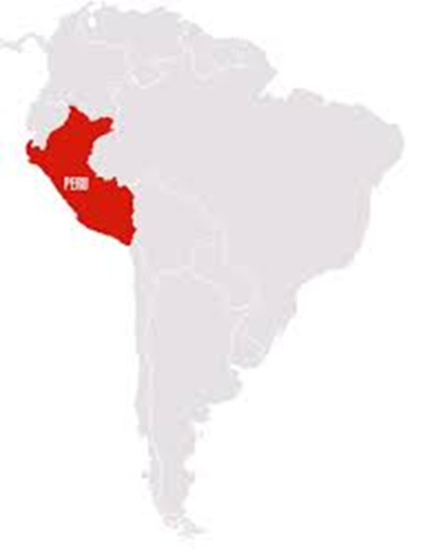
Overall Context
Main social and structural problems: Poverty, violence, corruption, limited access to health services
Peru is located in western South America. The country has a land area of 1,285,215 km² and 32,000,000 population.

Slide 3
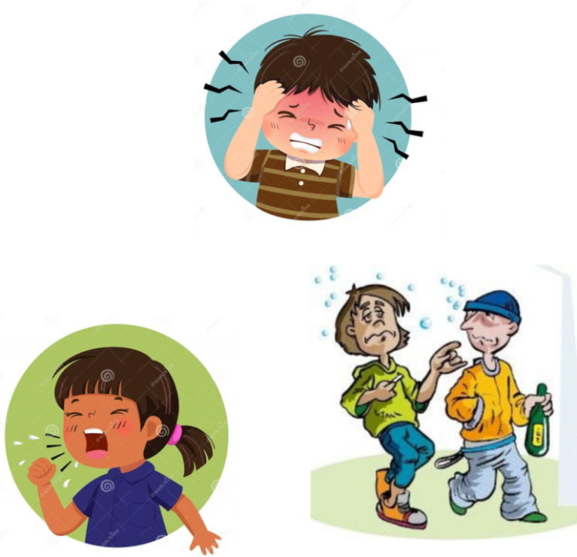
Critical Health Problems
Infectious Respiratory Diseases
Tuberculosis / AIDS
Mental health problems (Anxiety, depression)
Emerging Diseases (Zika, Dengue)
Harmful use of alcohol
Diabetes mellitus
Violence against women
Malnutrition in children
November 2019

Slide 4
Physical and mental health
There is a clear distinction made often between “mind” and “body”
Physical and mental healthcare have largely been disconnected
BODY – Physical health MIND - Mental Health

Slide 5
Physical and mental health
BODY
MIND
Common psychological interventions
Foundations unknown (mix of DBT, CBT, others or none)
Medical intervention «Based in evidence» (pharmacological basis) Mechanistic point of view

Slide 6
Main issues … but something is missing
Lack
of
exercise
TB
Chronic
pain
Substance
abuse
Anxiety disorders
Smoking
Depression
Diabetes

Slide 7
One challenge:
Missing key
ACT HELPS
How to share the same language and work as a team?
CBS helps to integrate psychological wellbeing and health as a whole
Team work (Clinicians, psychologists, other health workers )

Slide 8
An ACT-based perspective on behavioral health … a good start
Same goals Health Coordinated care model
Same language behavior Teamwork

Slide 9
An ACT-based healthcare perspective
Teamwork values

Slide 10
Gracias

